Slide 1
Chapter 3: Introduction to SQL

Slide 2
Chapter 3: Introduction to SQL
Overview of the SQL Query Language
Data Definition
Basic Query Structure
Additional Basic Operations
Set Operations
Null Values
Aggregate Functions
Nested Subqueries
Modification of the Database
Notes:
1

Slide 3
History
IBM Sequel language developed as part of System R project at the IBM San Jose Research Laboratory
Renamed Structured Query Language (SQL)
ANSI and ISO standard SQL:
SQL-86, SQL-89, SQL-92
SQL:1999, SQL:2003, SQL:2008
Commercial systems offer most, if not all, SQL-92 features, plus varying feature sets from later standards and special proprietary features.
Not all examples here may work on your particular system.

Slide 4
Data Definition Language
The SQL data-definition language (DDL) allows the specification of information about relations, including:
The schema for each relation.
The domain of values associated with each attribute.
Integrity constraints
And as we will see later, also other information such as
The set of indices to be maintained for each relations.
Security and authorization information for each relation.
The physical storage structure of each relation on disk.

Slide 5
Domain Types in SQL
char(n). Fixed length character string, with user-specified length n.
varchar(n). Variable length character strings, with user-specified maximum length n.
int. Integer (a finite subset of the integers that is machine-dependent).
smallint. Small integer (a machine-dependent subset of the integer domain type).
numeric(p,d). Fixed point number, with user-specified precision of p digits, with n digits to the right of decimal point. (ex., numeric(3,1), allows 44.5 to be stores exactly, but not 444.5 or 0.32)
real, double precision. Floating point and double-precision floating point numbers, with machine-dependent precision.
float(n). Floating point number, with user-specified precision of at least n digits.
More are covered in Chapter 4.

Slide 6
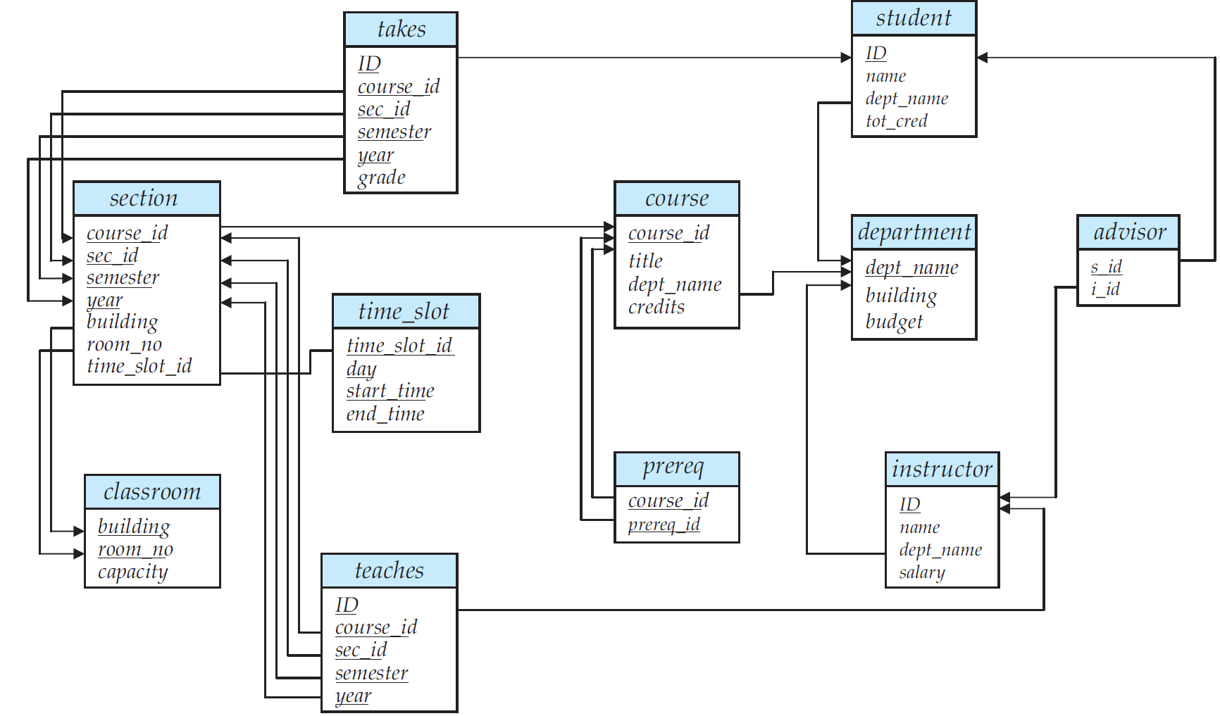
Schema Diagram for University Database

Slide 7
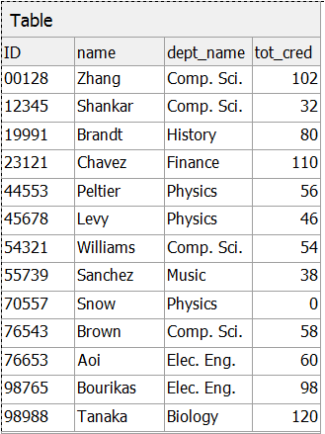
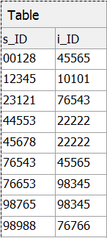
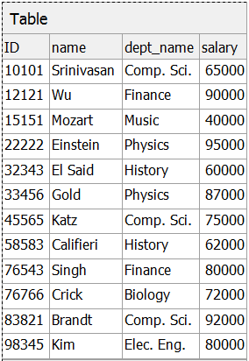
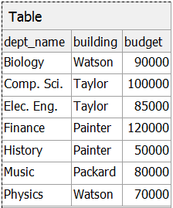
Relations for University Database
student
advisor
instructor
department

Slide 8
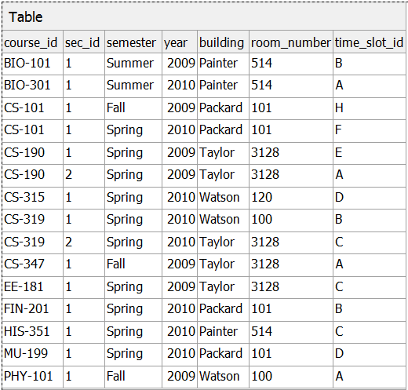
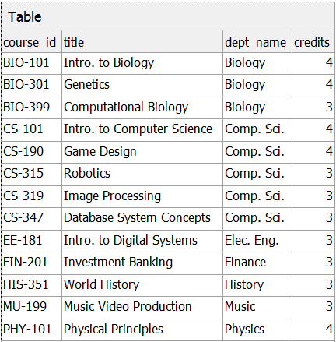
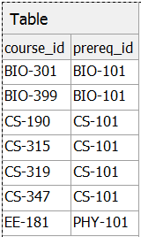
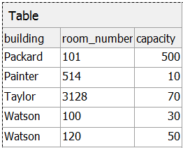
Relations for University Database
section
course
prereq
classroom

Slide 9
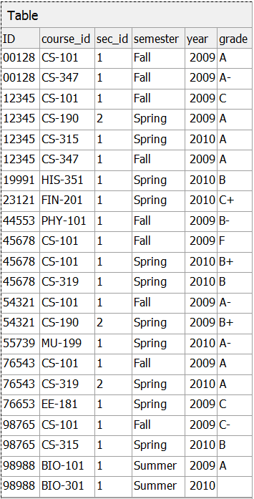
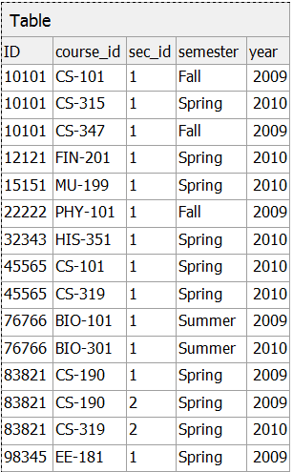
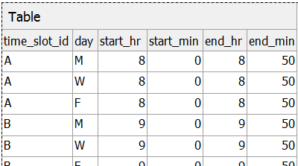
Relations for University Database
takes
teaches
time_slot

Slide 10
Create Table Construct
An SQL relation is defined using the create table command:
create table r (A₁ D₁, A₂ D₂, ..., A_{n} D_{n}, (integrity-constraint₁), ..., (integrity-constraint_{k}))
r is the name of the relation
each A_{i} is an attribute name in the schema of relation r
D_{i} is the data type of values in the domain of attribute A_{i}

Slide 11

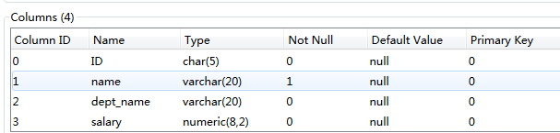
Create Table Construct
Example:
create table instructor ( ID char(5), name varchar(20) not null, dept_name varchar(20), salary numeric(8,2))
table
table structure in SQLite Manager

Slide 12
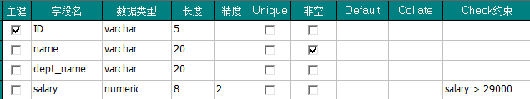

Integrity Constraints in Create Table
not null
primary key (A₁, ..., A_{n} )
foreign key (A_{m}, ..., A_{n} ) references r
primary key declaration on an attribute automatically ensures not null
Example: Declare ID as the primary key for instructor
create table instructor (
ID varchar(5),
name varchar(20) not null,
dept_name varchar(20),
salary numeric(8,2) check (salary > 29000),
primary key (ID),
foreign key (dept_name) references department on delete set null )
table structure in SQLite Developer

Slide 13

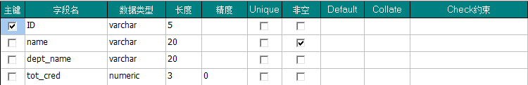
And a Few More Relation Definitions
create table student ( ID varchar(5), name varchar(20) not null, dept_name varchar(20), tot_cred numeric(3,0), primary key (ID), foreign key (dept_name) references department );
table
table structure in SQLite Developer

Slide 14
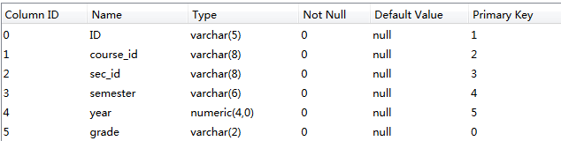
And a Few More Relation Definitions
create table takes ( ID varchar(5), course_id varchar(8), sec_id varchar(8), semester varchar(6), year numeric(4,0), grade varchar(2), primary key (ID, course_id, sec_id, semester, year), foreign key (ID) references student, foreign key (course_id, sec_id, semester, year) references section );
table structure in SQLite Manager

Slide 15
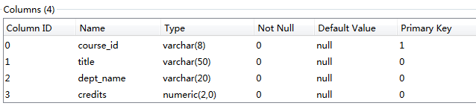
And more still
create table course ( course_id varchar(8) primary key, title varchar(50), dept_name varchar(20), credits numeric(2,0), foreign key (dept_name) references department );
Primary key declaration can be combined with attribute declaration as shown above
table structure in SQLite Manager

Slide 16
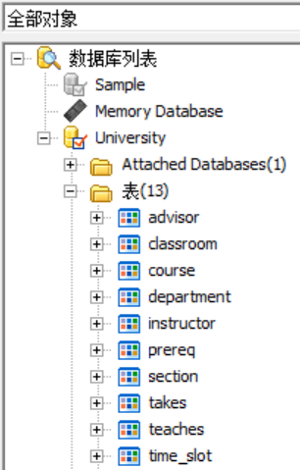
Drop and Alter Table Constructs
drop table student
Deletes the table and its contents
drop table student
alter table
alter table r add A D
where A is the name of the attribute to be added to relation r and D is the domain of A.
All tuples in the relation are assigned null as the value for the new attribute.
alter table r drop A
where A is the name of an attribute of relation r
Dropping of attributes not supported by many databases

Slide 17
Basic Query Structure
The SQL data-manipulation language (DML) provides the ability to query information, and insert, delete and update tuples
A typical SQL query has the form: select A₁, A₂, ..., A_{n} from r₁, r₂, ..., r_{m} where P
A_{i} represents an attribute
R_{i} represents a relation
P is a predicate.
This query is equivalent to the relational algebra expression.
The result of an SQL query is a relation.
Notes:
2

Slide 18
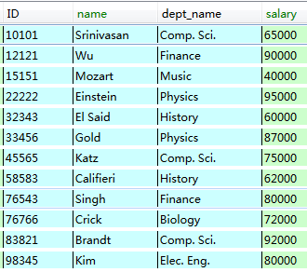
The select Clause
The select clause list the attributes desired in the result of a query
corresponds to the projection operation of the relational algebra
Example: find the names of all instructors:
select name from instructor
NOTE: SQL names are case insensitive (i.e., you may use upper- or lower-case letters.)
E.g. Name ≡ NAME ≡ name
Some people use upper case wherever we use bold font.
Notes:
3

Slide 19
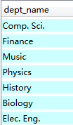

The select Clause (Cont.)
SQL allows duplicates in relations as well as in query results.
To force the elimination of duplicates, insert the keyword distinct after select.
Find the names of all departments with instructor, and remove duplicates
select distinct dept_name from instructor
The keyword all specifies that duplicates not be removed.
select all dept_name from instructor
distinct
all
Notes:
4

Slide 20
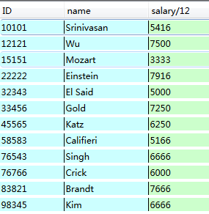
The select Clause (Cont.)
An asterisk in the select clause denotes “all attributes”
select * from instructor
The select clause can contain arithmetic expressions involving the operation, +, –, ∗, and /, and operating on constants or attributes of tuples.
monthly_salary
The query:
select ID, name, salary/12 from instructor
would return a relation that is the same as the instructor relation, except that the value of the attribute salary is divided by 12.
Can rename “salary/12” using the as clause select ID, name, salary/12 as monthly_salary
Notes:
5

Slide 21


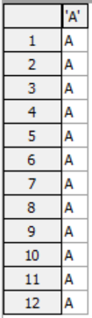
The select Clause (Cont.)
An attribute can be a literal with no from clause
select ‘437’
Results is a table with one column and a single row with value “437”
Can give the column a name using:
select ‘437’ as FOO
An attribute can be a literal with from clause
select ‘A’ from instructor
Result is a table with one column and N rows (number of tuples in the instructors table), each row with value “A”
Notes:
5

Slide 22

The where Clause
The where clause specifies conditions that the result must satisfy
Corresponds to the selection predicate of the relational algebra.
Comparison results can be combined using the logical connectives and, or, and not.
Comparisons can be applied to results of arithmetic expressions.
Find all instructors in Comp. Sci. dept with salary > 70000
select name from instructor where dept_name = 'Comp. Sci.' and salary > 70000
Notes:
6

Slide 23
The from Clause
The from clause lists the relations involved in the query
Corresponds to the Cartesian product operation of the relational algebra.
Find the Cartesian product instructor X teaches
select ∗ from instructor, teaches
generates every possible instructor – teaches pair, with all attributes from both relations
For common attributes (e.g., ID), the attributes in the resulting table are renamed using the relation name (e.g., instructor.ID)
Cartesian product not very useful directly, but useful combined with where-clause condition (selection operation in relational algebra)
Notes:
8

Slide 24
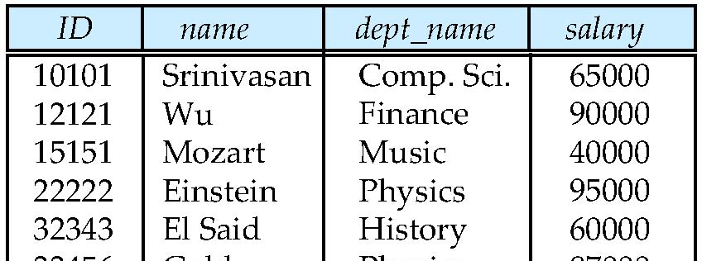
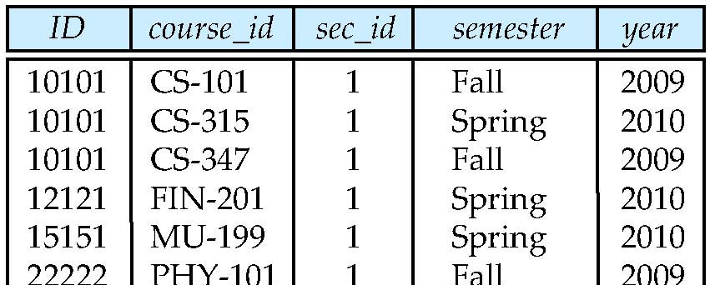
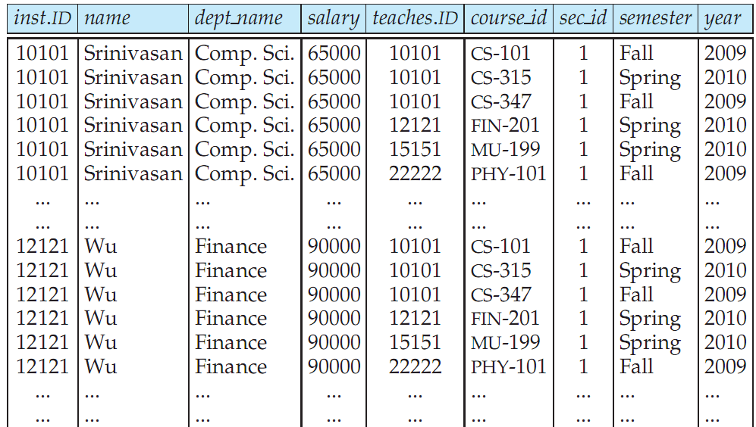
Cartesian Product: instructor X teaches
instructor
teaches

Slide 25
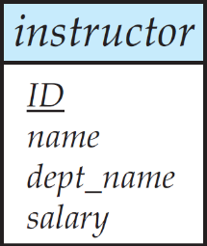
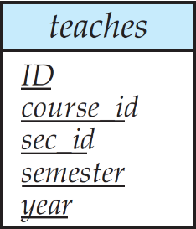
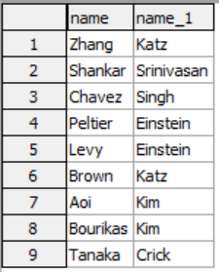
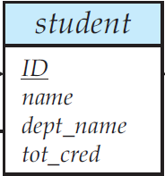
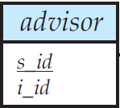
Joins
For all instructors who have taught some course, find their names and the course ID of the courses they taught.
select name, course_id from instructor, teaches where instructor.ID = teaches.ID
Find all names of the students who has an advisor and their advisor’s names.
select student.name, instructor.name
from student, advisor, instructor
where student.ID=advisor.s_ID and advisor.i_ID=instructor.ID

Slide 26
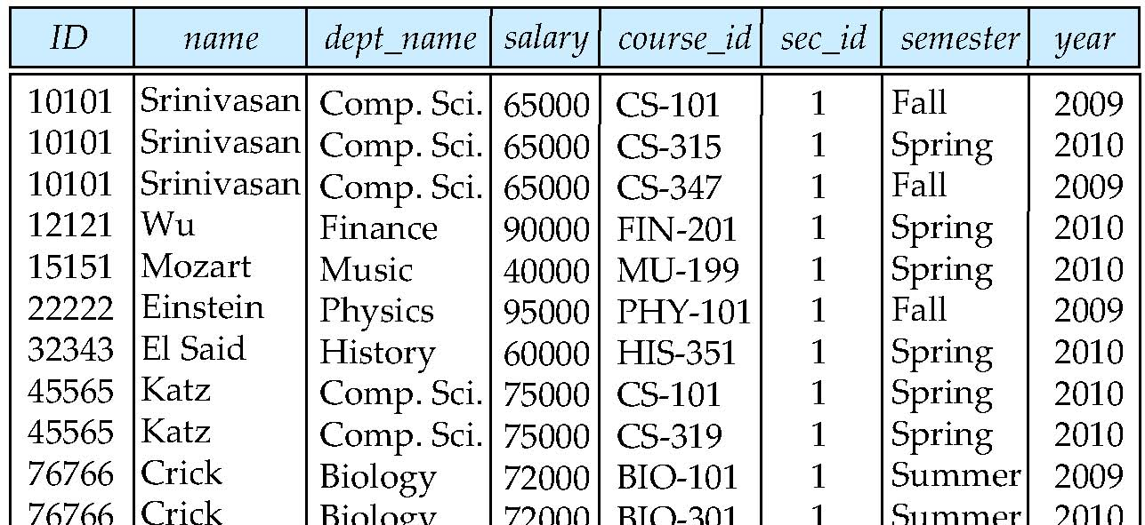
Natural Join
Natural join matches tuples with the same values for all common attributes, and retains only one copy of each common column
select * from instructor natural join teaches;

Slide 27
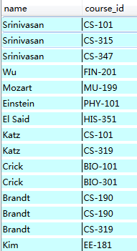
Natural Join Example
List the names of instructors along with the course ID of the courses that they taught.
select name, course_id from instructor, teaches where instructor.ID = teaches.ID;
select name, course_id from instructor natural join teaches;

Slide 28
Natural Join (Cont.)
Danger in natural join: beware of unrelated attributes with same name which get equated incorrectly
List the names of instructors along with the the titles of courses that they teach
select name, title from instructor natural join teaches natural join course;
Incorrect version (makes course.dept_name = instructor.dept_name)
natural join

Slide 29
Natural Join (Cont.)
Correct version
select name, title from instructor natural join teaches, course where teaches.course_id = course.course_id;
Another correct version
select name, title from (instructor natural join teaches) join course using(course_id);
natural join

Slide 30
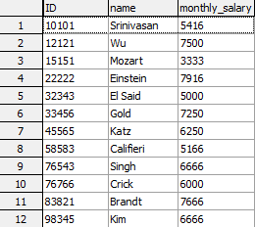

The Rename Operation
The SQL allows renaming relations and attributes using the as clause:
old-name as new-name
E.g.
select ID, name, salary/12 as monthly_salary from instructor
Find the names of all instructors who have a higher salary than some instructor in 'Comp. Sci'.
select distinct T. name from instructor as T, instructor as S where T.salary > S.salary and S.dept_name = 'Comp. Sci.'
Keyword as is optional and may be omitted instructor as T ≡ instructor T
Notes:
9

Slide 31

String Operations
SQL includes a string-matching operator for comparisons on character strings. The operator “like” uses patterns that are described using two special characters:
percent (%). The % character matches any substring.
underscore (_). The _ character matches any character.
Find the names of all instructors whose name includes the substring “in”.
select name from instructor where name like '%in%'
Match the string “100 %”
like '100 \%' escape '\'

Slide 32
String Operations (Cont.)
Patters are case sensitive.
Pattern matching examples:
'Intro%' matches any string beginning with “Intro”.
'%Comp%' matches any string containing “Comp” as a substring.
'_ _ _' matches any string of exactly three characters.
'_ _ _ %' matches any string of at least three characters.
SQL supports a variety of string operations such as
concatenation (using “||”)
converting from upper to lower case (and vice versa)
finding string length, extracting substrings, etc.

Slide 33


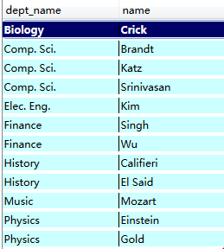
Ordering the Display of Tuples
List in alphabetic order the names of all instructors select distinct name from instructor order by name
We may specify desc for descending order or asc for ascending order, for each attribute; ascending order is the default.
Example: order by name desc
Can sort on multiple attributes
Example: order by dept_name, name

Slide 34


Where Clause Predicates
SQL includes a between comparison operator
Example: Find the names of all instructors with salary between $90,000 and $100,000 (that is, ≥ $90,000 and ≤ $100,000)
select name from instructor where salary between 90000 and 100000
Tuple comparison
select name, course_id from instructor, teaches where (instructor.ID, dept_name) = (teaches.ID, ’Biology’);
Notes:
7

Slide 35
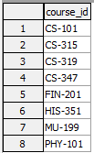


Set Operations
Find courses that ran in Fall 2009 or in Spring 2010
select course_id from section where semester = 'Fall' and year = 2009
union
select course_id from section where semester = 'Spring' and year = 2010
Find courses that ran in Fall 2009 and in Spring 2010
select course_id from section where semester = 'Fall' and year = 2009
intersect
select course_id from section where semester = 'Spring' and year = 2010
Find courses that ran in Fall 2009 but not in Spring 2010
select course_id from section where semester = 'Fall' and year = 2009
except
select course_id from section where semester = 'Spring' and year = 2010

Slide 36
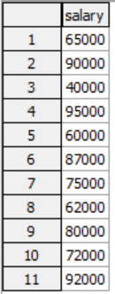
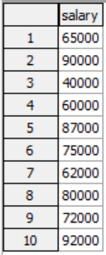

Set Operations (Cont.)
Find the salaries of all instructors that are less than the largest salary.
select distinct T.salary from instructor as T, instructor as S where T.salary < S.salary
Find all the salaries of all instructors
select distinct salary from instructor
Find the largest salary of all instructors.
(select “second query” ) except (select “first query”)
Notes:
9

Slide 37
Set Operations
Set operations union, intersect, and except
Each of the above operations automatically eliminates duplicates
To retain all duplicates use the corresponding multiset versions union all, intersect all and except all. Suppose a tuple occurs m times in r and n times in s, then, it occurs:
m + n times in r union all s
min(m,n) times in r intersect all s
max(0, m – n) times in r except all s

Slide 38
Null Values
It is possible for tuples to have a null value, denoted by null, for some of their attributes
null signifies an unknown value or that a value does not exist.
The result of any arithmetic expression involving null is null
Example: 5 + null returns null
The predicate is null can be used to check for null values.
Example: Find all instructors whose salary is null. select name from instructor where salary is null

Slide 39
Null Values and Three Valued Logic
Any comparison with null returns unknown
Example: 5 < null or null <> null or null = null
Three-valued logic using the truth value unknown:
OR: (unknown or true) = true, (unknown or false) = unknown (unknown or unknown) = unknown
AND: (true and unknown) = unknown, (false and unknown) = false, (unknown and unknown) = unknown
NOT: (not unknown) = unknown
“P is unknown” evaluates to true if predicate P evaluates to unknown
Result of where clause predicate is treated as false if it evaluates to unknown

Slide 40
Aggregate Functions
These functions operate on the multiset of values of a column of a relation, and return a value
avg: average value min: minimum value max: maximum value sum: sum of values count: number of values

Slide 41



Aggregate Functions (Cont.)
Find the average salary of instructors in the Computer Science department
select avg (salary) from instructor where dept_name= 'Comp. Sci.';
Find the total number of instructors who teach a course in the Spring 2010 semester
select count (distinct ID) from teaches where semester = 'Spring' and year = 2010
Find the number of tuples in the course relation
select count (*) from course;

Slide 42
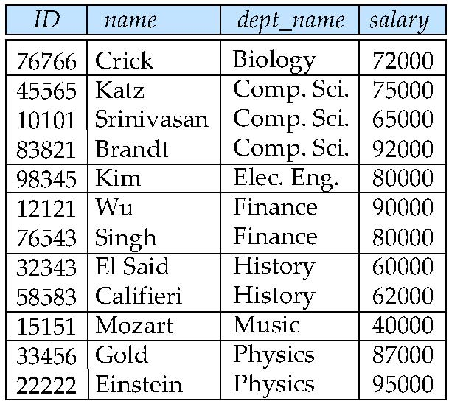
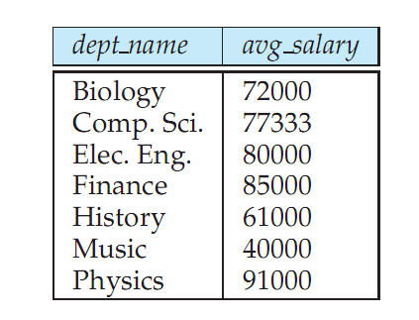
Aggregate Functions – Group By
Find the average salary of instructors in each department
select dept_name, avg (salary) from instructor group by dept_name;
Note: departments with no instructor will not appear in result

Slide 43
Aggregation (Cont.)
Attributes in select clause outside of aggregate functions must appear in group by list
/* erroneous query */ select dept_name, ID, avg (salary) from instructor group by dept_name;
X

Slide 44
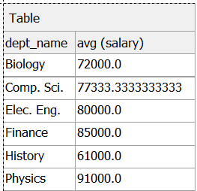
Aggregate Functions – Having Clause
Find the names and average salaries of all departments whose average salary is greater than 42000
select dept_name, avg (salary)
from instructor
group by dept_name
having avg (salary) > 42000;
Note: predicates in the having clause are applied after the formation of groups whereas predicates in the where clause are applied before forming groups

Slide 45

Null Values and Aggregates
Total all salaries
select sum (salary ) from instructor
Above statement ignores null amounts
Result is null if there is no non-null amount
All aggregate operations except count(*) ignore tuples with null values on the aggregated attributes
What if collection has only null values?
count returns 0
all other aggregates return null

Slide 46
Nested Subqueries
SQL provides a mechanism for the nesting of subqueries. A subquery is a select-from-where expression that is nested within another query.
The nesting can be done in the following SQL query select A₁, A₂, ..., A_{n} from r₁, r₂, ..., r_{m} where P
as follows:
A_{i} can be replaced be a subquery that generates a single value.
r_{i} can be replaced by any valid subquery
P can be replaced with an expression of the form:
B <operation> (subquery)
Where B is an attribute and <operation> to be defined later.

Slide 47
Subqueries in the Where Clause

Slide 48
Subqueries in the Where Clause
A common use of subqueries is to perform tests:
For set membership
For set comparisons
For set cardinality.

Slide 49
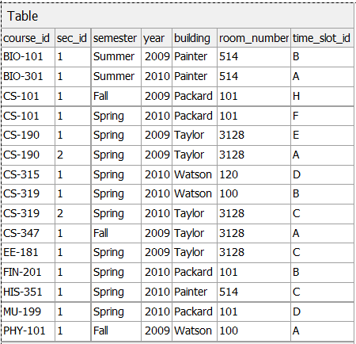

Set Membership
Find courses offered in Fall 2009 and in Spring 2010
select distinct course_id
from section
where semester = 'Fall' and year= 2009 and course_id in (select course_id
from section
where semester = 'Spring' and year= 2010);
= intersect

Slide 50
Set Membership
Find courses offered in Fall 2009 but not in Spring 2010
select distinct course_id
from section
where semester = 'Fall' and year= 2009 and course_id not in (select course_id
from section
where semester = 'Spring' and year= 2010);
= except

Slide 51

Set Membership (Cont.)
Find the total number of (distinct) students who have taken course sections taught by the instructor with ID 10101
select count (distinct ID)
from takes
where (course_id, sec_id, semester, year) in (select course_id, sec_id, semester, year
from teaches
where teaches.ID= 10101);
Note: Above query can be written in a much simpler manner. The formulation above is simply to illustrate SQL features.

Slide 52

Set Comparison – “some” Clause
Find names of instructors with salary greater than that of some (at least one) instructor in the Biology department.
select distinct T.name
from instructor as T, instructor as S
where T.salary > S.salary and S.dept_name = 'Biology';
Same query using > some clause
select name
from instructor
where salary > some (select salary
from instructor
where dept_name = 'Biology');

Slide 53
Definition of Some Clause
F <comp> some r ⇔ ∃ t ∈ r such that (F <comp> t ) Where <comp> can be: <, ≤, >, =, ≠
0
(5 < some
5
) = true
(read: 5 < some tuple in the relation)
6
0
(5 < some
5
) = false
0
(5 = some
) = true
5
0
(5 ≠ some
5
) = true (since 0 ≠ 5)
(= some) ≡ in
However, (≠ some) ≡ not in

Slide 54
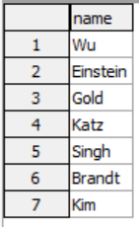
Set Comparison – “all” Clause
Find the names of all instructors whose salary is greater than the salary of all instructors in the Biology department.
select name
from instructor
where salary > all (select salary
from instructor
where dept_name = 'Biology');

Slide 55
Definition of all Clause
F <comp> all r ⇔ ∀ t ∈ r (F <comp> t)
0
(5 < all
5
) = false
6
6
(5 < all
) = true
10
4
(5 = all
) = false
5
4
(5 ≠ all
) = true (since 5 ≠ 4 and 5 ≠ 6)
6
(≠ all) ≡ not in
However, (= all) ≡ in

Slide 56
Test for Empty Relations
The exists construct returns the value true if the argument subquery is nonempty.
exists r ⇔ r ≠ Ø
not exists r ⇔ r = Ø

Slide 57

Use of “exists” Clause
Yet another way of specifying the query “Find all courses taught in both the Fall 2009 semester and in the Spring 2010 semester”
select course_id from section as S where semester = ’Fall’ and year = 2009 and exists (select * from section as T where semester = ’Spring’ and year= 2010 and S.course_id = T.course_id);
Correlation name – variable S in the outer query
Correlated subquery – the inner query

Slide 58
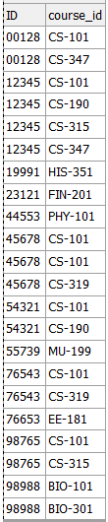



Not Exists
Find all students who have taken all courses offered in the Biology department.
select distinct S.ID, S.name
from student as S
where not exists ( select course_id
from course
where dept_name = 'Biology' except
select T.course_id
from takes as T
where S.ID = T.ID);
Note that X – Y = Ø ⇔ X ⊆ Y
Note: Cannot write this query using = all and its variants

Slide 59
Another way by using “not in”
Find all students who have taken all courses offered in the Biology department.
select distinct S.ID, S.name
from student as S
where not exists ( select course_id
from course
where dept_name = 'Biology' and course_id not in
(select T.course_id
from takes as T
where S.ID = T.ID));

Slide 60
Test for Absence of Duplicate Tuples
The unique construct tests whether a subquery has any duplicate tuples in its result.
The unique construct evaluates to “true” if a given subquery contains no duplicates .
Find all courses that were offered at most once in 2009
select T.course_id from course as T where unique (select R.course_id from section as R where T.course_id= R.course_id and R.year = 2009);

Slide 61
Subqueries in the Form Clause

Slide 62
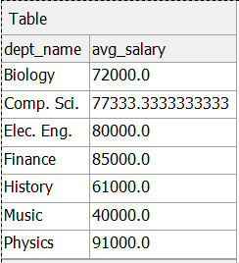
Subqueries in the From Clause
SQL allows a subquery expression to be used in the from clause
Find the average instructors' salaries of those departments where the average salary is greater than $42,000.
select dept_name, avg_salary from (select dept_name, avg (salary) as avg_salary from instructor group by dept_name) where avg_salary > 42000;
Note that we do not need to use the having clause
Another way to write above query
select dept_name, avg_salary from (select dept_name, avg (salary) from instructor group by dept_name) as dept_avg (dept_name, avg_salary) where avg_salary > 42000;

Slide 63
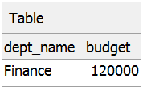
With Clause
The with clause provides a way of defining a temporary view whose definition is available only to the query in which the with clause occurs.
Find all departments with the maximum budget
with max_budget (value) as (select max(budget) from department) select dept_name, budget from department, max_budget where department.budget = max_budget.value;

Slide 64
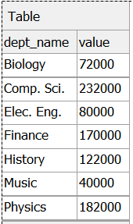

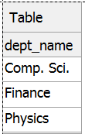
Complex Queries using With Clause
With clause is very useful for writing complex queries
Supported by most database systems, with minor syntax variations
Find all departments where the total salary is greater than the average of the total salary at all departments
dept_total
dept_total_avg
with dept_total (dept_name, value) as
(select dept_name, sum(salary)
from instructor
group by dept_name),
dept_total_avg(value) as
(select avg(value)
from dept_total)
select dept_name
from dept_total, dept_total_avg
where dept_total.value >= dept_total_avg.value;

Slide 65
Subqueries in the Select Clause

Slide 66
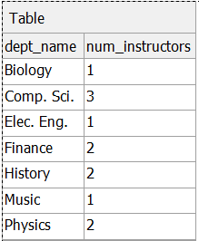

Scalar Subquery
Scalar subquery is one which is used where a single value is expected
E.g. select dept_name, (select count(*) from instructor where department.dept_name = instructor.dept_name) as num_instructors from department;
E.g. select name from instructor where salary * 10 > (select budget from department where department.dept_name = instructor.dept_name)
Runtime error if subquery returns more than one result tuple

Slide 67
Modification of the Database
Insertion of new tuples into a given relation
Deletion of tuples from a given relation
Updating values in some tuples in a given relation

Slide 68
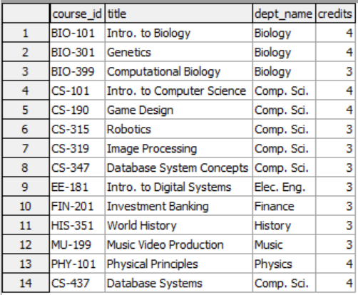
Modification of the Database – Insertion
Add a new tuple to course insert into course values ('CS-437', 'Database Systems', 'Comp. Sci.', 4);
or equivalently insert into course (course_id, title, dept_name, credits) values ('CS-437', 'Database Systems', 'Comp. Sci.', 4);

Slide 69
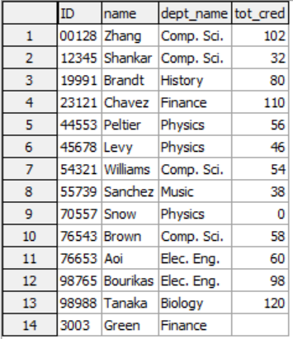
Modification of the Database – Insertion
Add a new tuple to student with tot_creds set to null
insert into student values ('3003', 'Green', 'Finance', null);

Slide 70
Insertion (Cont.)
Add a new tuple to instructor with name set to null
insert into instructor values ('10211', null, 'Biology', 66000);
X
table instructor

Slide 71
Insertion (Cont.)
Add all instructors to the student relation with tot_creds set to 0
insert into student select ID, name, dept_name, 0 from instructor
The select from where statement is evaluated fully before any of its results are inserted into the relation (otherwise queries like insert into table1 select * from table1 would cause problems, if table1 did not have any primary key defined.

Slide 72
Modification of the Database – Deletion
Delete all instructors
delete from instructor
Remove all tuples from table, but retains table
Delete all instructors from the Finance department
delete from instructor where dept_name= 'Finance';
Delete all tuples in the instructor relation for those instructors associated with a department located in the Watson building.
delete from instructor where dept_name in (select dept_name from department where building = 'Watson');

Slide 73
Deletion (Cont.)
Delete all instructors whose salary is less than the average salary of instructors
delete from instructor
where salary < (select avg (salary) from instructor);
Problem: as we delete tuples from deposit, the average salary changes
Solution used in SQL:
1. First, compute avg salary and find all tuples to delete
2. Next, delete all tuples found above (without recomputing avg or retesting the tuples)

Slide 74
Modification of the Database – Updates
Increase salaries of instructors whose salary is over $100,000 by 3%, and all others receive a 5% raise
Write two update statements:
update instructor set salary = salary * 1.03 where salary > 100000; update instructor set salary = salary * 1.05 where salary <= 100000;
The order is important
Can be done better using the case statement (next slide)

Slide 75
Case Statement for Conditional Updates
Same query as before but with case statement
update instructor
set salary = case
when salary <= 100000 then salary * 1.05 else salary * 1.03 end

Slide 76
Updates with Scalar Subqueries
Recompute and update tot_creds value for all students
update student S set tot_cred = ( select sum(credits) from takes natural join course where S.ID= takes.ID and takes.grade <> 'F' and takes.grade is not null);
Sets tot_creds to 0 for students who have not taken any course
Instead of sum(credits), use:
case when sum(credits) is not null then sum(credits) else 0 end

Slide 77
End of Chapter 3

